Slide 1
ANLY 506 Exploratory Data Analysis
Lecture 4 Introduction to Exploratory Data Analysis

Slide 2
Outline
Review
Formulating a Research Question/Problem Statement
Finding the data required to answer the research question or address the problem statement
Retrieving data and information
What is Exploratory Data Analysis (EDA)?
Why is it important?
Types of Statistical and Graphical EDA

Slide 3
Review
Formulating a Research Question or Problem Statement
Finding the data required
Retrieving data or information

Slide 4
What is Exploratory Data Analysis?
Exploratory Data Analysis (EDA) is an approach that uses data to develop understanding
EDA is not a full analysis that starts from understanding, e.g. a hypothesis
EDA is an important first step in understanding data, e.g. identifying any relationship between variables or potential outliers
From Lecture 1, EDA employs a variety of techniques to:
maximize insight into a data set;
uncover underlying structure;
extract important variables;
detect outliers and anomalies;
test underlying assumptions;
develop parsimonious models; and
determine optimal factor settings.
The National Institute of Standards: What is EDA?

Slide 5
Why is EDA Important?
To review from Lecture 1 again, Quantitative and Qualitative Data Exploration go Hand-in-Hand
Quantitative methods include: Summary/Descriptive Statistics; Hypothesis testing; Analysis of Variance; Point Estimates and Confidence Intervals; and Least Squares Regression… But this sounds a lot like classical data analysis!
The difference is that in performing exploratory data analysis we let the data guide us. In classical data analysis we already know enough about the data to know what model to impose on it, etc.
For example, EDA can be used to develop suggestions for hypotheses. EDA can be used to evaluate assumptions. EDA can be used to determine appropriate statistical tools and techniques.
Where do qualitative methods come in? Qualitative methods are really focused on graphical methods – which form the core of EDA.

Slide 6
Why is EDA Important Cont.?
EDA is important to maximize insight into the data including the underlying structure of a dat set. When completed and done properly, EDA should provide:
a good-fitting, parsimonious model
a list of outliers
a sense of robustness of conclusions
estimates for parameters
uncertainties for those estimates
a ranked list of important factors
conclusions as to whether individual factors are statistically significant
optimal settings
This means that EDA is not just about getting a “feeling” for data, there are specific qualitative and quantitative objectives that EDA should achieve.
The National Institute of Standards: What is EDA?

Slide 7
EDA techniques
Some EDA techniques we will look at are listed here. There are many other types of EDA techniques as well.
Graphical
Univariate
Box plot (distribution)
Density plot (distribution)
Multivariate
Line graph (trend, relationships)
Correlation heat map (relationships)
Scatter plot (relationships)
Clustering (relationships)
Numeric
Univariate or Multivariate
Statistical summary
Transformations (PCA)

Slide 8
Statistical Programming languageS
Leading languages: R, Python, SAS
R and Python
Open source
Free
High level of capability with advanced techniques
Choice is matter of preference
SAS
Closed source
Expensive ($10,000 annually for a personal license)
High capability with basic and intermediate data analysis, less capability with most advanced techniques

Slide 9
Competitor analysis
Your boss has asked you to examine the competition. He has provided you a dataset which contains the monthly revenue for the year 2016, in millions of USD, for your company, along with 5 competitor companies.
Save the file from Moodle to your working directory.
Change your working directory with setwd(“filepath”). When you paste in the file path, make sure that you replace all / with //
Read the data into R
df=read.csv("companies.csv")

Slide 10
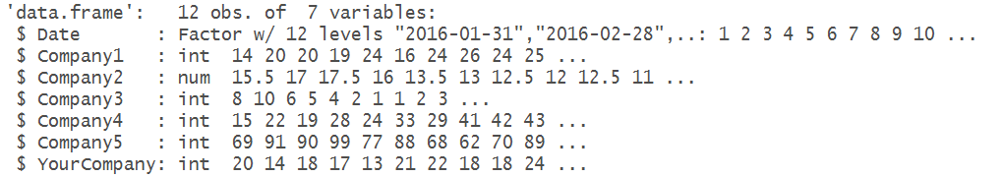
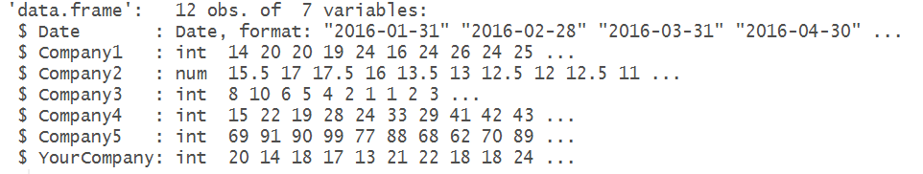
STR Command
Use str() to take a quick look at the data. Good practice to always run str() after reading in data
str(df)
Convert Date variable to a Date type
df$Date=as.Date(df$Date)
str(df)

Slide 11
Numeric - Statistical Summary
In R, standard statistical summary includes the minimum, 1st quartile, median, mean, 3rd quartile, and maximum for each variable in the dataset.
2
2 – Q1 – 25% of data below this point
3
5 – Q2 (Median) – 50% of data below this point
6
8 – Q3 – 75% of data below this point
8

Slide 12
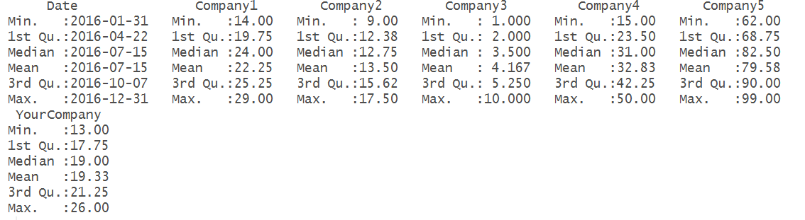
Numeric - Statistical Summary
The summary() command is used to create a statistical summary which includes minimum, 1st quartile, median, mean, 3rd quartile, and maximum.
summary(df)

Slide 13
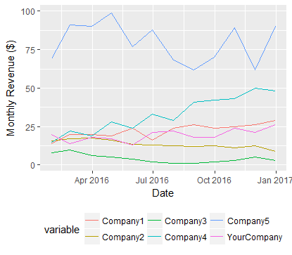
Graphical – Line PLot
df1 <- melt(df, id="Date")
ggplot(data=df1, aes(x=Date, y=value, color=variable)) + geom_line() + labs(y="Monthly Revenue ($)")

Slide 14
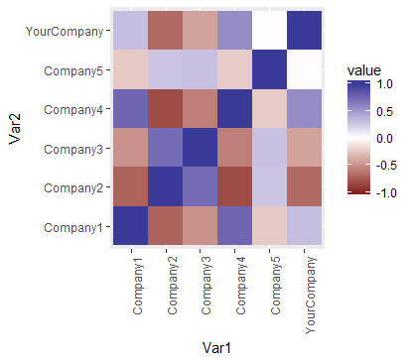
Graphical – Correlation Heat Map
The color in the plot represents the correlation.
Blue = positive
Red = negative
Darker color = stronger relationship, higher correlation
Ignore diagonal – All variables have 100% correlation with themselves

Slide 15
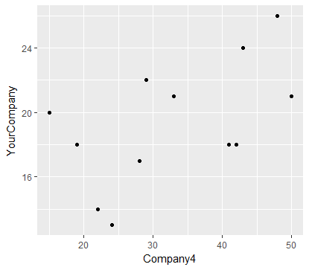
Graphical – Scatter PLot
df2=df[c("Company4","YourCompany")]
ggplot(data=df2,aes(x=Company4,y=YourCompany))+geom_point()
Decently strong positive linear relationship is shown in the plot

Slide 16
Resources
To see the complete listing of graphical techniques at NIST go to http://www.itl.nist.gov/div898/handbook/eda/section3/eda33.htm
To see the complete listing of quantitative techniques at NIST go to http://www.itl.nist.gov/div898/handbook/eda/section3/eda35.htm

